Slide 1
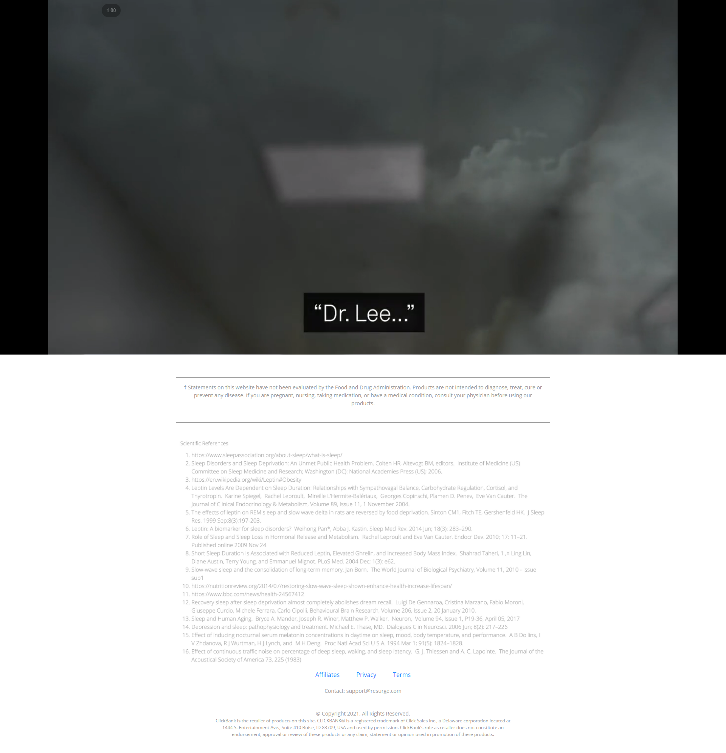
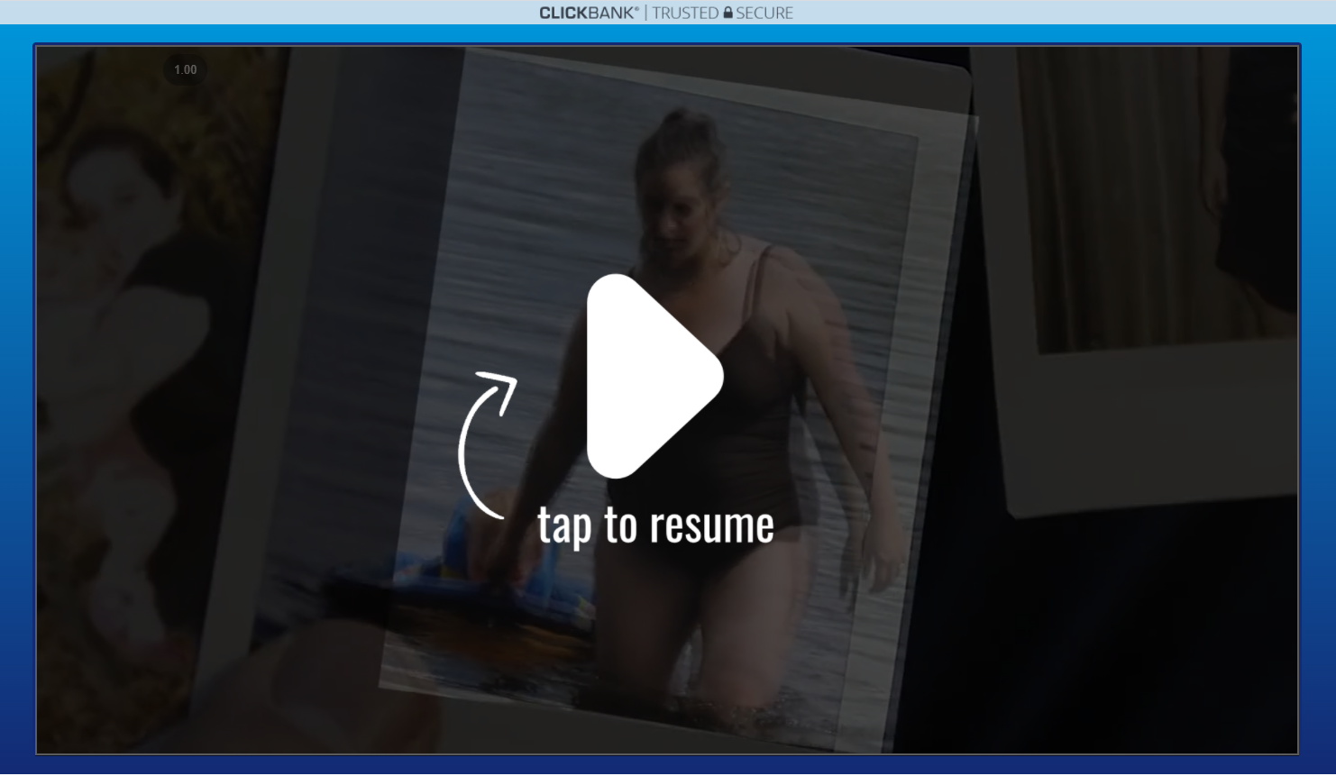
DESKTOP
@Vik
Please check this on desktop for the YT Prostate Pro page
https://resurge.com/welcome/
Use the same video player
Auto-play with no sound
Use all same images for click to play / tap to resume etc
When pause should also be big
Copy format at the bottom
Disclaimer
Scientific References (I will send this)
Links should only be Privacy Disclaimer
5) Copyright
6) Support
Paused example

Slide 2
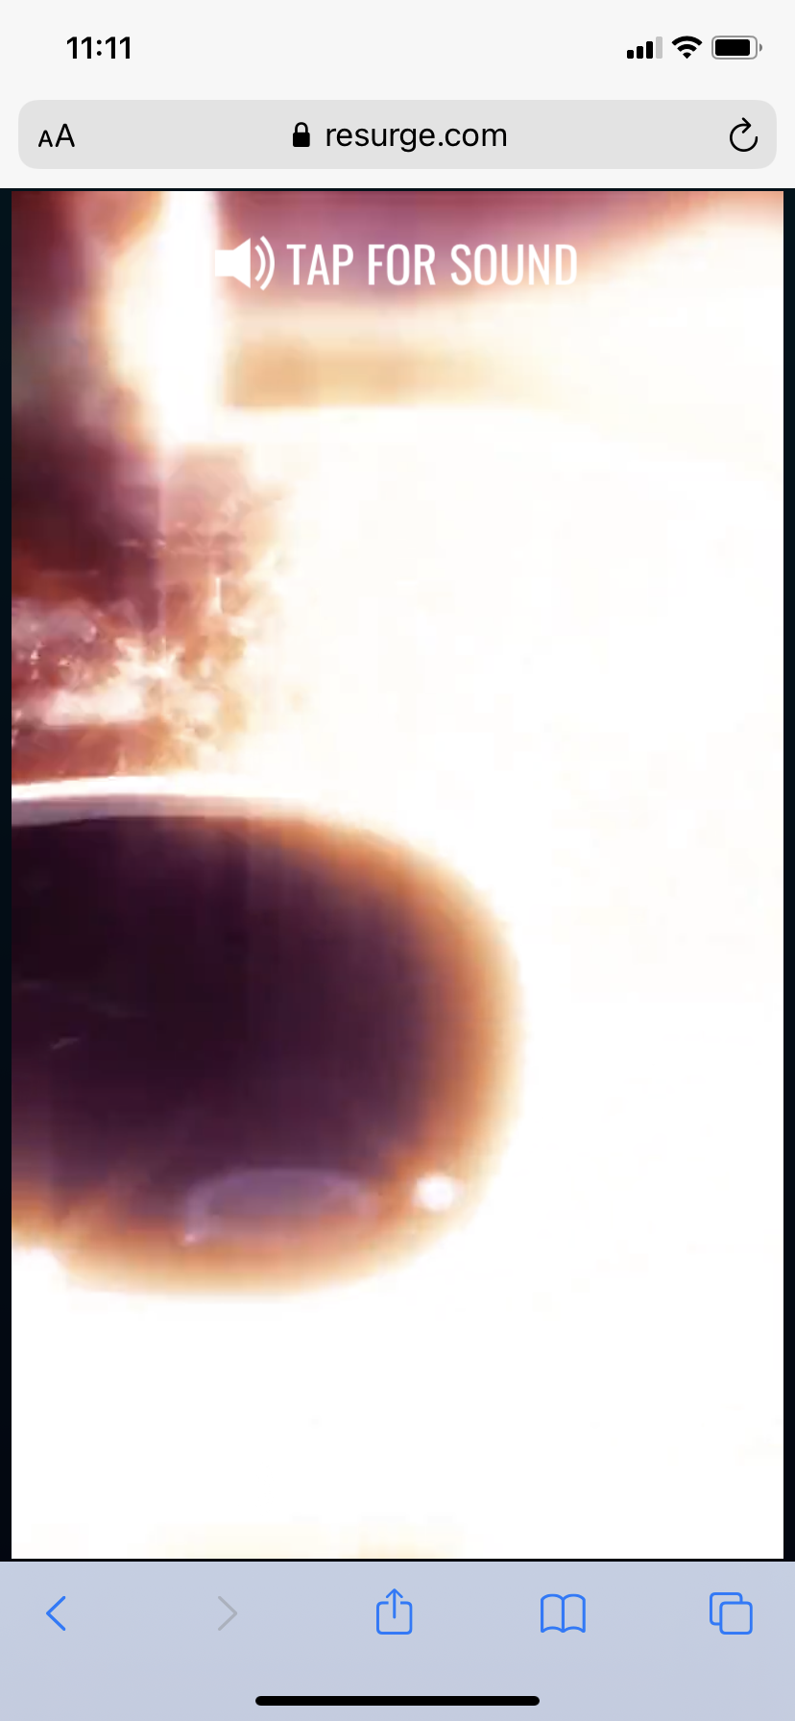
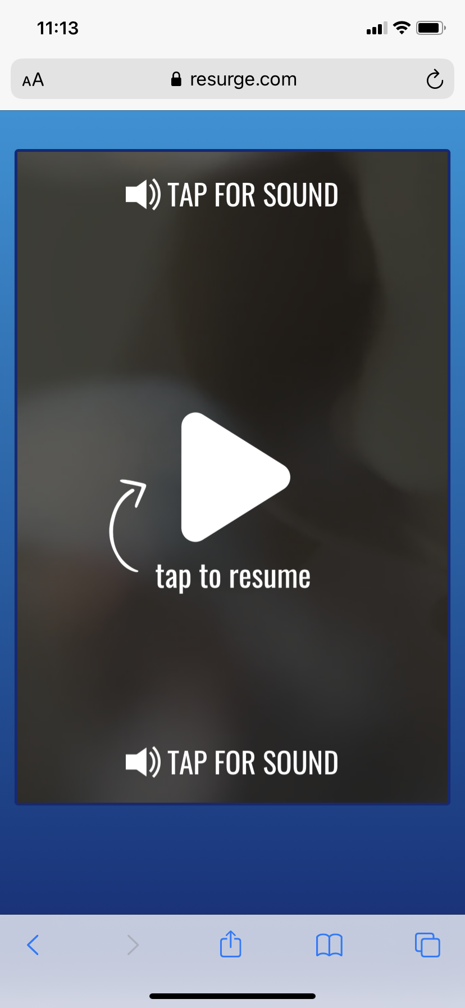
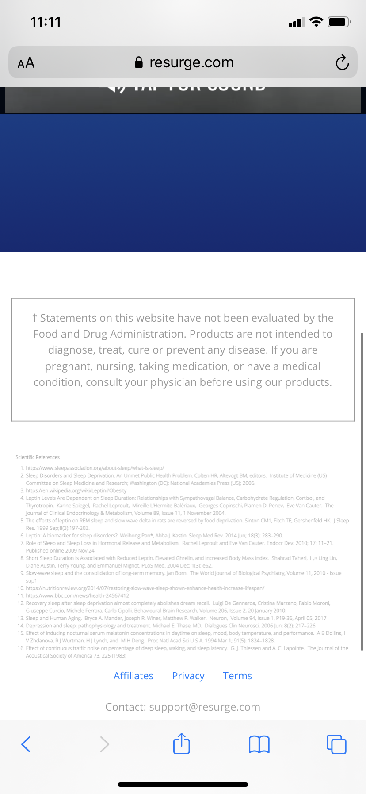
MOBILE
@Vik
Very important open this link on your phone and check it
https://resurge.com/welcome/
Use the same video player
Auto-play on mobile
Use all same images for click to play / tap to resume etc
Copy format at the bottom
Disclaimer
Scientific References (I will send this)
Links should only be Privacy Disclaimer
5) Copyright
6) Support
VERY IMPORTANT CHECK THIS ON MOBILE AND MAKE SURE EXACTLY THE SAME
Paused example
Must take up whole screen
Have exact same space etc
Exact same section at the bottom

